Slide 1

Basic Details of the Team and Problem Statement
Ministry/Organization Name/Student Innovation :
Ministry of Electronics and Information Technology (MEITY)
PS Code : PK844
Problem Statement Title : Terms and Condition Checking Tool
Team Name : Team Infinity
Team Leader Name : Vinod Narendra Choudhari
Institute Code (AISHE) : C34168
Institute Name : VIVA Institute of Technology
Theme Name : Miscellaneous

Slide 2
Problem Statement Details
Business with an online presence must include certain details in order to abide the Electronic Commerce Regulations, such as full company details.
Website terms and conditions are the best places to include such information.
As stated earlier, ALL websites interact with user data in some way.
Data breaches and attacks on personal information by sites is not a new thing.
Such sites lack transparency into their terms & condition.
Addressing this problem we will be developing a tool which checks the T&C and generates report of the issues found.

Slide 3
Solution Details
Approach Details
Our approach to solve this problem by using NLP and ML.
We will train an ML model for checking terms and condition.
For training of model we will take dataset and apply NLP on the preprocessed dataset.
After using NLP we will pass this data through our model for training.
For making ML model we will use SCIKIT-Learn.
After training, our ML model will be deployed in our web app.
After clicking these terms and condition will pass through our model and it will give output as follows.
It will generate a report in which term and condition that are suspicious will be highlighted.
Block Diagram
Notes:
User will copy paste the terms & condition in textbox.
After pasting pasting user will click on the "Check T&C" button given below the textbox.

Slide 4
Technology Stack Details
Dependencies Details
PYTHON
NLP : NLTK
ML : Scikit-learn
Flask
NLP
ML
Flask
HTML
CSS
JAVASCRIPT

Slide 5
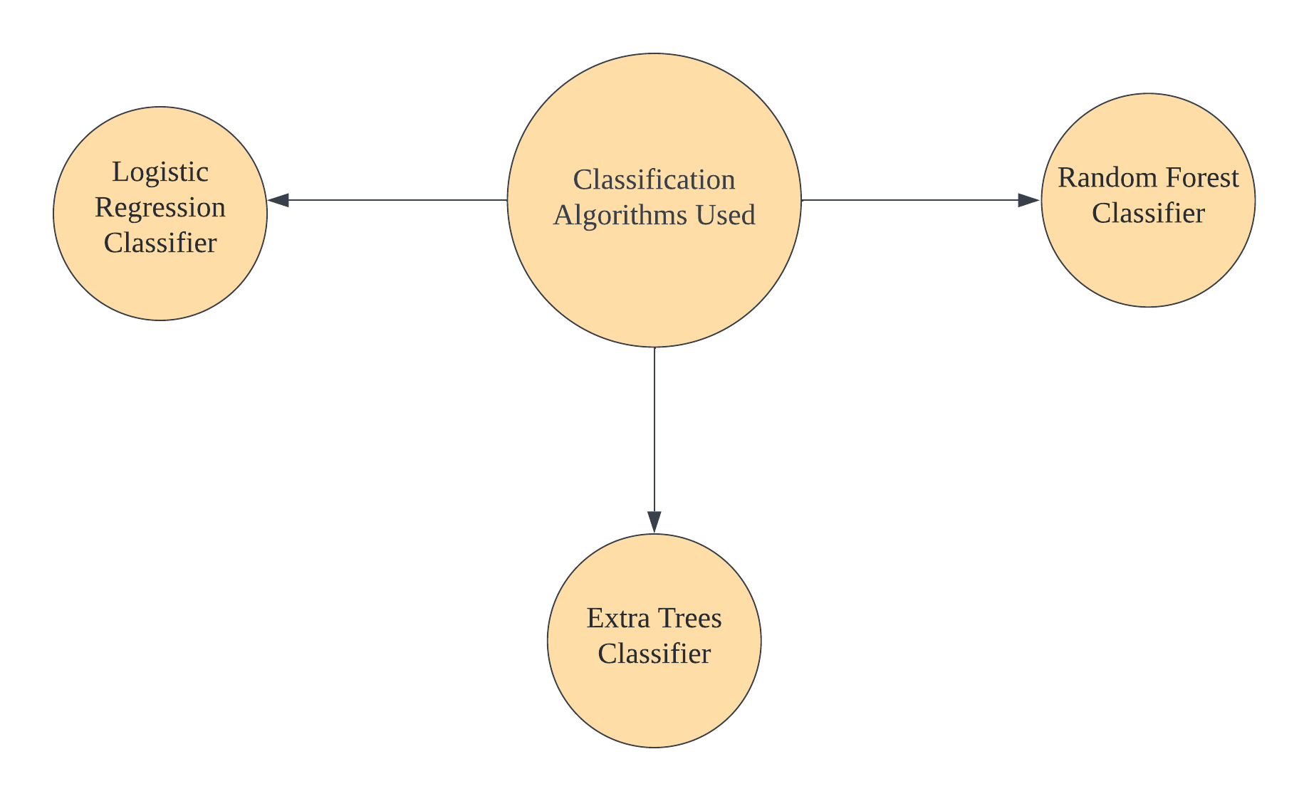
Algorithms Used

Slide 6
Team Member Details
Team Leader Name: Vinod Choudhari
Branch : BE Stream : CSE Year : IV
Team Member 1 Name: Akshita Raut
Branch : BE Stream : CSE Year : IV
Team Member 2 Name: Hanish Patil
Branch : BE Stream : CSE Year : IV
Team Member 3 Name: Krutika Penkar
Branch : BE Stream : EXTC Year : IV
Team Member 4 Name: Sakshi Shinde
Branch : BE Stream : CSE Year : IV
Team Member 5 Name: Omsai Nagvekar
Branch : BE Stream : CSE Year : IV
Team Mentor Name: Prof. Vinit Raut
Category : Academic Expertise : Cloud Computing, DBMS Domain Experience : 4 years

